Slide 1
SDC Assignment 4
ICP Lidar localization

Slide 2
Data
You can download the data here: ROS bag.
Play the rosbag by: $ rosbag play sdc_hw4.bag -r 0.1
You can change the play rate of rosbag by -r.
ROS topics:
/clock (rosgraph_msgs/Clock)
/gps (geometry_msgs/PoseStamped) ---------------- Simulated GPS (~10Hz)
/gt_odom (nav_msgs/Odometry) ---------------------------------------------------- Ground truth odometry
/lidar_points (sensor_msgs/PointCloud2) ------------------------------------------------------ Lidar pointcloud
/tf (tf2_msgs/TFMessage) ------------------------------- Transformations between coordinates

Slide 3
Goal
In this assignment, you should learn how to use ICP to achieve Lidar localization.
You should use ICP to match the current Lidar scan of self-driving car with Lidar map.
Learn to use the tf to transform the sensor msg to the correct frame
Learn how to publish and subscribe the message on ROS
The first try and practice of the SDC Localization Competition

Slide 4
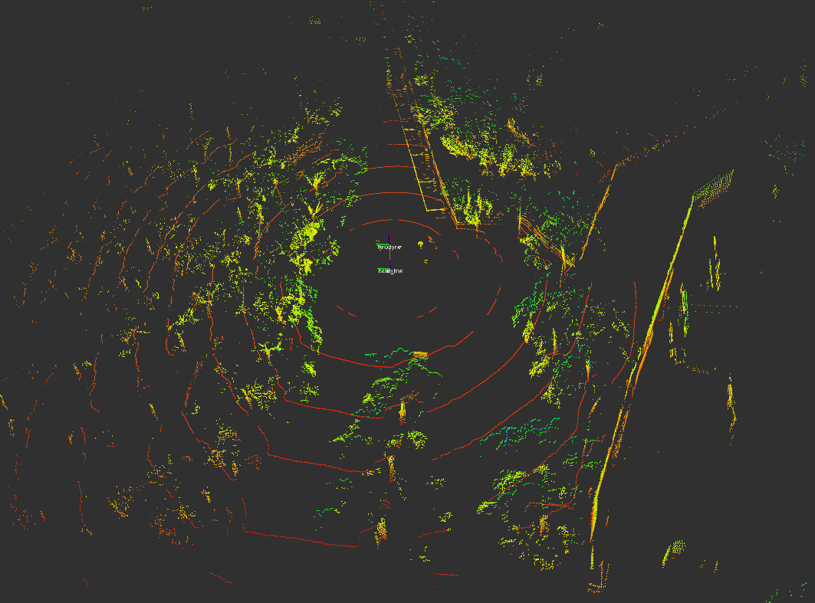
Lidar Scan
The /lidar_points topic in rosbag is the Lidar scan of self-driving car.
The message type of Lidar scan is sensor_msgs/PointCloud2.msg.
The frame_id of the Lidar scan is velodyne.
You can visualize Lidar scan in rviz:

Slide 5
GPS
The /gps topic in rosbag is the gps data of self-driving car.
The message type of gps data is geometry_msgs/PointStamped.
In this task, you should use gps data as the initial guess of the self-driving car.

Slide 6
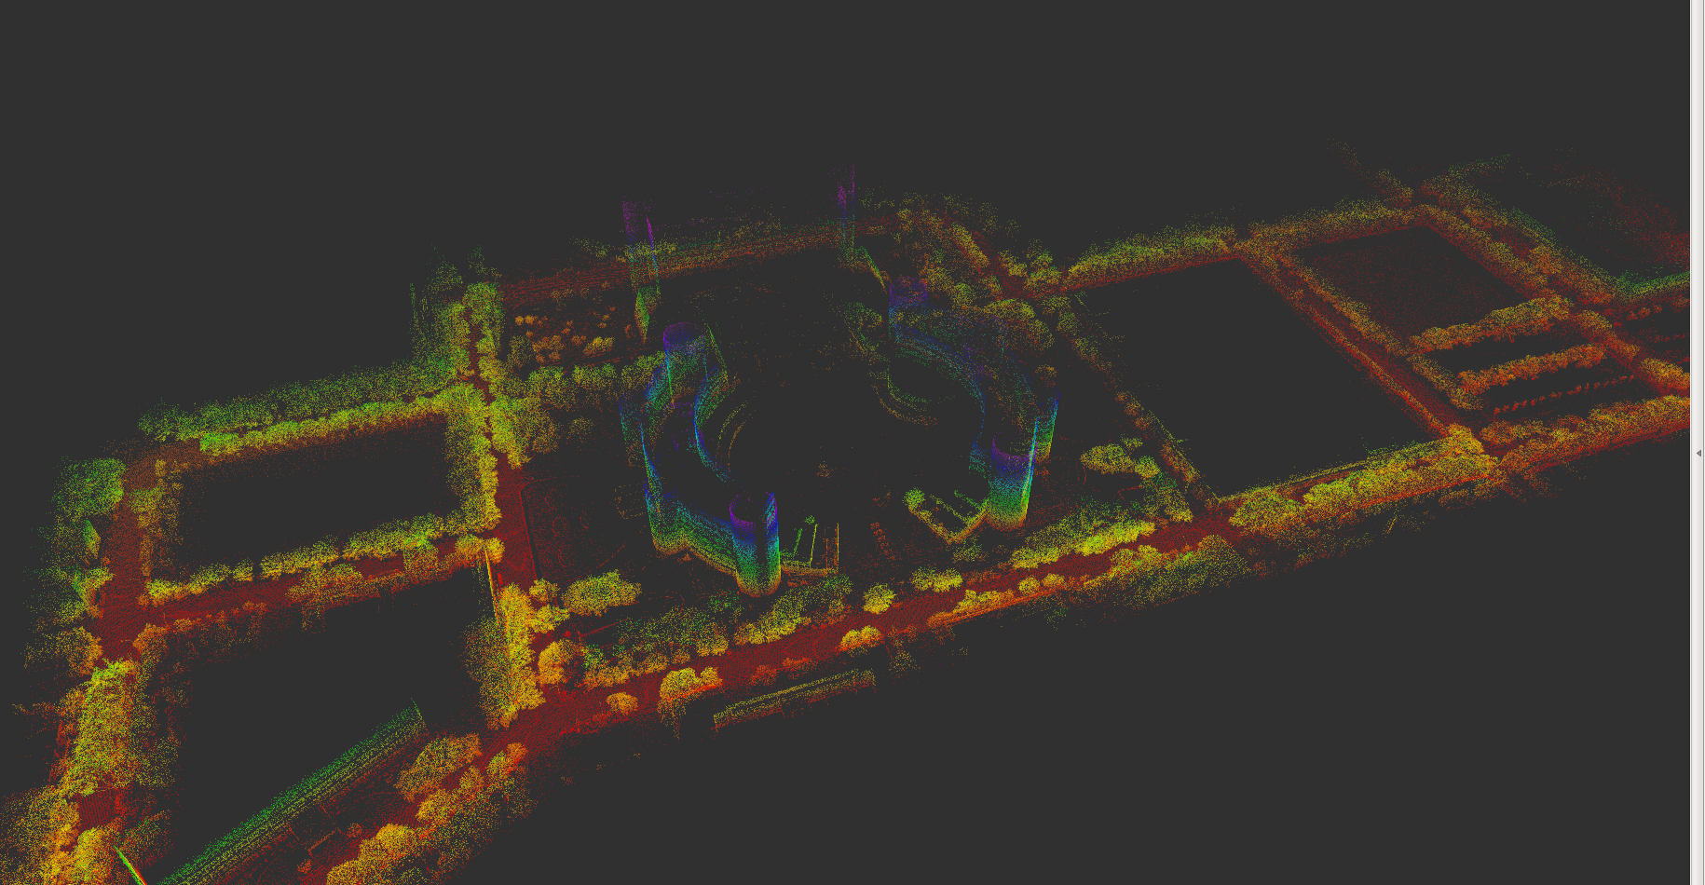
Lidar Map
You can download Lidar point cloud map from here.
The map is in .pcd format.
You can visualize Lidar map in rviz:

Slide 7
PCL Library
PCL library is the library for 3D point cloud processing.
Please take a look at PCL official website and tutorial.

Slide 8
tf
tf2 is the transform library from the ROS, we can use this library to transform the different frame coordinate to the same frame.
For the case of this homework, we have main three frames:
world -> the lidar point cloud map frame
velodyne -> the lidar points cloud scan frame
base_link -> the car frame
<important> The /map frame in rosbag is needless in this task. You can just ignore it.
The gt_odom we provide is based on the world frame, thus you need to get the transform of /lidar_points from velodyne to base_link. You can reference the tf_listener to get the transform.

Slide 9
Assignment - Publish and visualize the Lidar map
Use loadPCDFile function in PCL library to load Lidar map as pcl::PointCloud.
Downsample the map using voxel grid filter.
Convert Lidar map to ros sensor_msgs/PointCloud2.msg message by pcl_conversions.
Use a ros node to load Lidar map and publish pointcloud as ros topic with name “map” at 1 Hz.
To be noticed, You should set the “map/header/frame_id” of your map as “world”.
Visualize it in rviz:
Set fixed frame to “world”.
Press “Add” → “By topic” → choose “map”.

Slide 10
Assignment - ICP localization
PCL library provides several scan matching algorithm, including ICP.
Here is the tutorial of ICP and document of ICP library.
<Important> You should take a look at usage example in document of ICP library and understand the meaning of each parameters.
By doing scan matching, we can estimate the transform between two scan. To localize where the car is, we simply perform scan matching between current Lidar scan and Lidar map.
<Hint>
You should use GPS data as the initial guess of the first ICP matching.
After first ICP matching, you can simply use the result of previous matching result as the initial guess of ICP.
Use ICP with initial guess:
icp.align(*cloud, initial_guess) // initial_guess is type of Eigen::Matrix4f
To be noticed, GPS didn’t provide rotation information of self-driving car, so we provide you the yaw angle of the starting point. You should use this value in your initial guess:
Yaw = -2.2370340344819 rad

Slide 11
Assignment - ICP localization
Create a new ros node to do following process:
Load Lidar map.
Subscribe “gps” and “lidar_points” topic.
Downsample the scan of the pointcloud using voxel grid filter to reduce the computation time.
Do ICP matching of the map and lidar scan pointcloud.
Use pcl_ros::transformPointCloud to transform the lidar scan to the base_link frame first.
Publish your lidar scan pointcloud after doing ICP.
Set the header/frame_id as “world”, thus you can compare your result with map.
Publish your localization result as nav_msgs/Odometry.msg message type.
To be noticed, you should set:
/header/frame_id as “world”
/child_frame_id as “base_link”

Slide 12
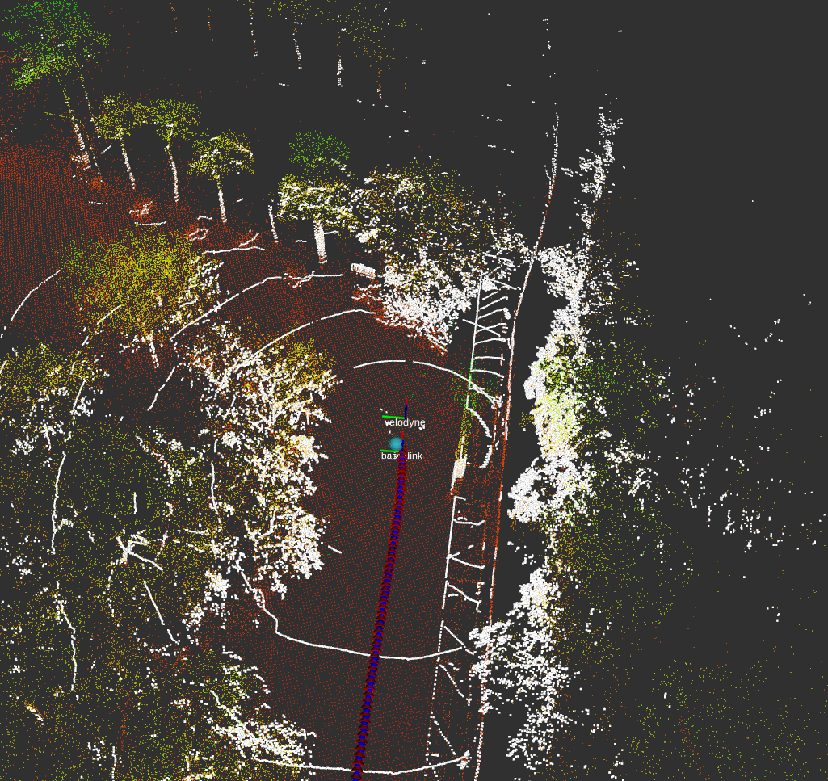
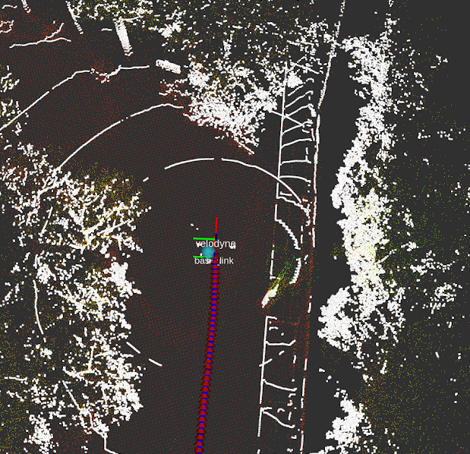
Assignment - Resulting
Screenshot your localization result. It should include the red arrow represent ground truth, blue arrow represent your result, current Lidar scan, and Lidar map.
Visualize it in rviz:
Set fixed frame to “world”.
Press “Add” → “By topic” → choose the topic you need to visualize.
Red arrows: ground truth odometry
Blue arrows: Your result
Light blue: GPS
White pointcloud: Lidar pointcloud
Colorful pointcloud: Map pointcloud

Slide 13
Submission
A PDF file include your result screenshot and name it as <student_id>_hw4.pdf
Deadline: 2020/11/08 Sun 00:00

